Slide 1
Double Link list

Slide 2
Variation of Link List
Doubly linked lists
Each node points to not only successor but the predecessor
There are two NULL: at the first and last nodes in the list
Advantage: given a node, it is easy to visit its predecessor. Convenient to traverse lists backwards
∅
A
B
C
C
∅
Head
Tail

Slide 3
Link List Applications
Implementation of stack and queues.
Implementation of graphs : Adjacency list is most popular which is uses linked list to store adjacent vertices.
Dynamic memory allocation : We use linked list of free blocks.
Maintaining directory of names
Performing arithmetic operations on long integers
Manipulation of polynomials by storing constants in the node of linked list representing sparse matrices.

Slide 4

Structure of node
struct node
{
int data;
node * next;
node*prev;
};
node*head;
node *tail;
node

Slide 5
Insert a node at the end of the Double Link List
void insert_End(int val)
{
struct node*temp;
temp=new node;
if(head==NULL)
{
temp->data=val;
temp->next=NULL;
temp->prev=NULL;
head=temp;
tail=temp;}
}
else{
temp->data=val;
temp->next=NULL;
temp->prev=tail;
tail->next=temp;
tail=temp;
}
return;

Slide 6
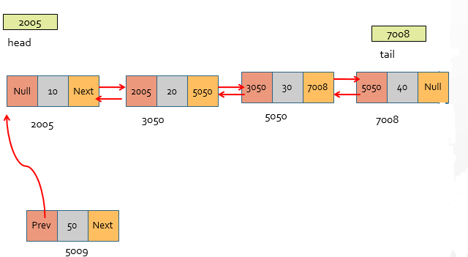
Insert a node at Beginning of the Double Link list

Slide 7
Insert a node at Beginning of the Double Link list
void addBegin(int val)
{struct node *temp;
if(head==NULL)
{ cout<<"Create the list first";
return;}
else{
temp=new node;
temp->prev=NULL;
temp->data=val;
temp->next=head;
head->prev=temp;
head=temp;
}
}

Slide 8
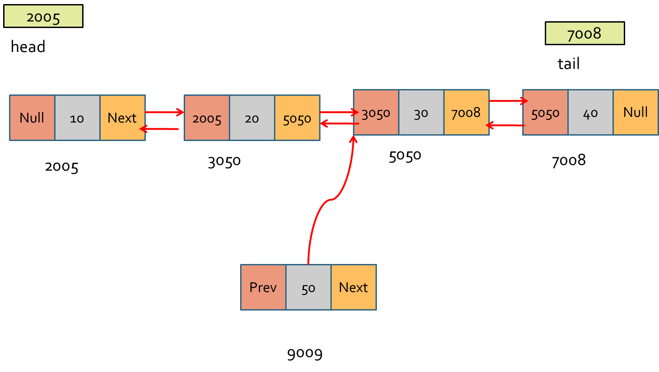
Insert a node at position of the Double Link list

Slide 9
Insert a node at position of the Double Link list
void InsertPos(int val,int pos)
{
node *tmp,*q;
if(head==NULL)
{ cout<<"First create the list"<<endl;
return;
}
q=head;
for(int i=0;i<pos;i++)
{
q=q->next;
if(q==NULL)
{cout<<“Invalid number of node”;
return;}}

Slide 10
Insert a node at position of the Double Link list
tmp=new node;
tmp->data=val;
if(q->next==NULL)
{ tmp->prev=tail;
tail->next=tmp;
tail=tmp;
tmp->next=NULL;}
else
{ tmp->next=q->next;
q->next=tmp;
tmp->prev=q;}
}
}

Slide 11
Display list Forward
void PrintForward()
{
node *ptr=head;
while(ptr!=NULL)
{
cout<<ptr->data<<" ";
ptr=ptr->next;
}
cout<<endl;
}

Slide 12
Display list backward
void PrintBackward()
{
node *ptr=tail;
while(ptr!=NULL)
{
cout<<ptr->data<<" ";
ptr=ptr->prev;
}
}

Slide 13
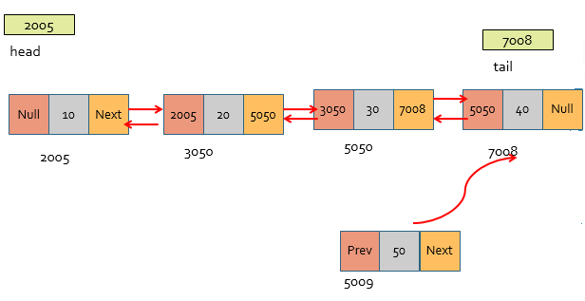
Insert a node at the end of the Double Link List

Slide 14
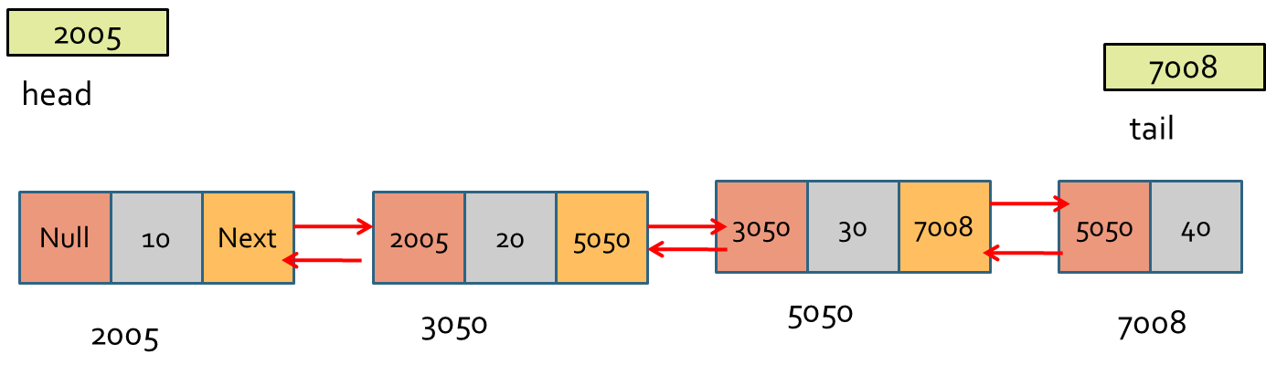
Delete a node from the beginning of Double link list
deleteBeg()
{
node *temp,*temp1;
temp=head;
head=head->next;
head->prev=NULL;
free(temp);
}

Slide 15
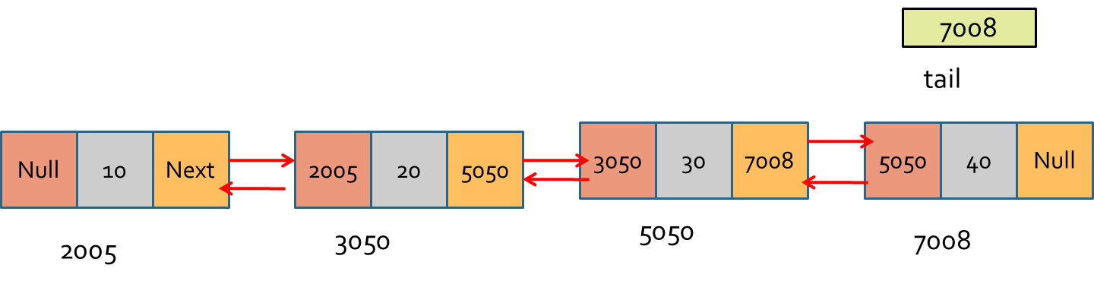
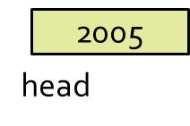
Delete a node from the end of Double link list
void DeleteEnd()
{
node*temp;
temp=tail;
temp1=temp->prev;
temp1->next=NULL;
tail=temp1;
free(temp);
}

Slide 16
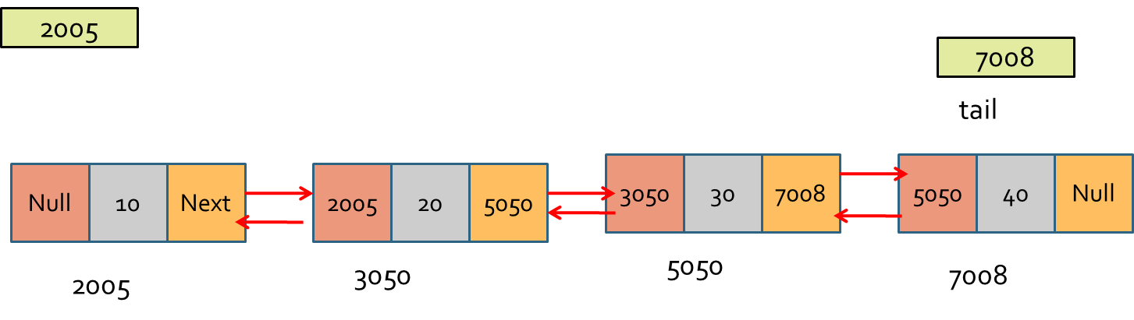
Delete a node from the position of Double link list
void Delete(int x)
{ node *temp;
node*temp1;
node*temp2;
temp=head;
while(temp->data!=x)
temp=temp->next;
temp1=temp->prev;
temp2=temp->next;
temp1->next=temp2;
temp2->prev=temp1;
free(temp);}

Slide 17
Array versus Linked Lists
Linked lists are more complex to code and manage than arrays, but they have some distinct advantages.
Dynamic: a linked list can easily grow and shrink in size.
We don’t need to know how many nodes will be in the list. They are created in memory as needed.
In contrast, the size of a C++ array is fixed at compilation time.
Easy and fast insertions and deletions
To insert or delete an element in an array, we need to copy to temporary variables to make room for new elements or close the gap caused by deleted elements.
With a linked list, no need to move other nodes. Only need to reset some pointers.

